Slide 1


IT BY DESIGN
FREE GUIDE · AI AT WORK
AI at work,
without the gaps
How lean South African teams can do more with AI, and close the IT gaps that come with it.
INSIDE
01
Do more — win back time with AI
p.04 →
02
Stay protected — the new risks, inside and out
p.08 →
03
Close the gaps — the foundations AI stands on
p.15 →
04
Find out where you stand — a six-question check
p.21 →
Follow Lerato’s story through all four parts. Click or tap any line to jump there.
Built from AI at Work, our October 2026 session with Sophos. Written for South African teams of 10 to 200 people.
25 min
6
90 days
R0
TO READ
QUESTIONS TO SCORE
STEP-BY-STEP PLAN
NOTHING TO SIGN
Notes:
COVER. Contents lines are clickable (invisible link areas sit over each line). Title highlight in dark lime. Stats are features of the guide itself, not company claims.

Slide 2




AI AT WORK, WITHOUT THE GAPS
02 / 24
START HERE
Your team is already using AI.
Is your IT ready for it?
Much of the AI in your business arrived without a project. Someone tried a free tool to write an email, summarise a meeting or tidy a spreadsheet, and it stuck.
That’s a good sign: your people want time back. The questions are what those tools can reach, and where your information goes once it’s typed in. This guide covers both sides in plain language, through the story of one business’s first 90 days.
80%
of AI users at small and mid-sized companies bring their own AI tools to work.
8 IN 10
SOURCE · MICROSOFT AND LINKEDIN, WORK TREND INDEX 2024 · GLOBAL SURVEY
HOW THIS GUIDE WORKS
Your turn
Lerato’s story
Check our numbers
Short exercises with a lime tag. A pen and a few minutes.
One business, seven chapters. Follow the purple tag.
Every figure is sourced. Page numbers are clickable.
WHO IT’S FOR
WHAT THIS ISN’T
Owners, managing directors, finance and operations managers: whoever ends up answering the IT questions. No technical background needed.
A pitch for an AI tool. There’s no licence quote at the end, just the ground our team covers with clients, written so you can cover it yourself.
SevenC · IT by Design
↑ Back to contents
sevenc.co.za/assessment
Notes:
Source for 80%: Microsoft and LinkedIn, 2024 Work Trend Index (published 8 May 2024): 75% of employees use AI at work; 78% of AI users bring their own tools; 80% at small and medium-sized companies. https://virtualizationreview.com/Articles/2024/05/08/state-of-ai-at-work.aspx — check for a newer edition before reprinting.

Slide 3








AI AT WORK, WITHOUT THE GAPS
03 / 24
LERATO’S STORY · 1 OF 7
ILLUSTRATIVE
Meet Lerato.
She never applied to run IT.
MONDAY · 07:40
Lerato is the operations manager at a 45-person logistics business with offices in Midrand and Durban. Three years ago, the person who “did the computers” resigned, and the job landed on her desk because someone had to take it.
This morning the managing director forwarded her an article with one line on top: “Should we be doing this AI thing?” Lerato laughed, because they already are. A sales rep drafts quotes in a free chatbot. Finance asked one to tidy the debtors list. Someone records meetings with an app on their phone. Nobody approved any of it, and nobody stopped it.
Her real question isn’t whether to use AI. It’s whether to keep pretending it isn’t happening, or to do it properly.
LERATO’S BUSINESS AT A GLANCE
WHAT SHE KNOWS
PEOPLE
People are already using AI
45, across two offices
The licence bill keeps going up
WHERE
Backups are “handled”
Midrand and Durban
EMAIL AND FILES
Microsoft 365 Business Standard
WHAT SHE DOESN’T KNOW YET
IT SUPPORT
Which tools, and what’s gone into them
An outside provider, on call
Who can open the payroll folder
WHO RUNS IT
Lerato, part-time, by default
Whether anyone has tested a restore
AI POLICY
Who controls the admin accounts
None yet
ABOUT LERATO
Lerato’s story is a composite. Her name and business are invented, but every situation in it comes from what South African businesses of 10 to 200 people tell us. Follow the purple tag: seven short chapters, one for each step of her first 90 days.
SevenC · IT by Design
↑ Back to contents
sevenc.co.za/assessment
Notes:
Prologue. Lerato and her business are an invented composite, labelled ILLUSTRATIVE on every story page. The situations reflect patterns in the Managed IT Services Playbook interviews (anonymised): the person who ended up owning IT, unapproved AI tools, licence creep, untested backups. No client is described.

Slide 4








AI AT WORK, WITHOUT THE GAPS
PART 1 OF 4
04 / 24
01
PART ONE
Do more with
what you already have
AI is most useful on the work your team repeats every week, inside Outlook, Teams, Excel and your own files.
WHERE AI EARNS ITS KEEP
Six jobs AI already does well for a lean team
Draft and rewrite
Summarise
Analyse
First drafts of emails, proposals and policies, in your own tone.
Long email threads and Teams meetings boiled down to decisions and actions.
A first pass at a spreadsheet: totals, trends and the questions worth asking.
Find
Reply
Ask your own data
Ask for a document in plain words instead of hunting through folders.
Suggested answers to routine customer questions, checked by a person.
At SevenC, AI over our finance and client data turned days of exports into seconds.
67%
of large South African companies use generative AI regularly, up from 45% a year earlier.
SOURCE · WORLD WIDE WORX, SA GENERATIVE AI ROADMAP 2025 · 100+ MEDIUM AND LARGE SA COMPANIES
SevenC · IT by Design
↑ Back to contents
sevenc.co.za/assessment
Notes:
Source for 67%/45%: World Wide Worx, The South African Generative AI Roadmap 2025 (with Dell Technologies and Intel), 100+ medium and large enterprises. Reported by Engineering News, 17 July 2025: https://www.engineeringnews.co.za/article/marked-increase-in-companies-using-genai-but-market-still-maturing-study-2025-07-17. The "Ask your own data" line is SevenC's own experience, as presented at AI at Work (8 October 2026).

Slide 5

AI AT WORK, WITHOUT THE GAPS
PART 1 OF 4
05 / 24
01 · DO MORE
What an AI assistant
actually does
You don’t need to understand the maths. You do need to know where its answers come from, and where they go wrong.
01
02
03
04
You ask
It gathers
It predicts
You check
A question or instruction in plain words. This is the prompt.
What it learned in training, plus what you give it: a document, a thread, the files your login can reach.
It writes the most likely answer, word by word. Confident whether it’s right or not.
A person reads it, fixes it and decides. This step is never optional.
LERATO’S STORY · 2 OF 7
ILLUSTRATIVE
Lerato’s first test was small. She asked Copilot Chat to summarise a 40-email thread about a late delivery, and had the gist within minutes. Then she asked it to draft the apology to the client. It was polite, well written, and promised a delivery date nobody had agreed. She deleted one sentence and sent the rest.
GOOD AT
NOT GOOD AT
First drafts in your tone, from a few lines of notes
Facts it wasn’t given: it fills gaps, confidently
Summaries of long threads, documents and meetings
Numbers: check totals against the source
Turning messy notes into lists, tables and actions
Judgement calls about people, money or risk
Explaining jargon, clauses or error messages
Knowing what’s confidential: that part is your job
SevenC · IT by Design
↑ Back to contents
sevenc.co.za/assessment
Notes:
Plain-language explainer of how an AI assistant produces answers. Lerato’s story beat (chapter 2) illustrates why a person always checks. No statistics on this page.

Slide 6

AI AT WORK, WITHOUT THE GAPS
PART 1 OF 4
06 / 24
01 · DO MORE
Start with the time drain,
not the tool
The quickest wins come from one task your team repeats every week. Find it first, then try AI on it.
YOUR TURN · 5 MIN
List the three tasks that eat the most hours each week. Be specific: “weekly sales report”, not “admin”.
#
THE TASK
WHO DOES IT
HOURS A WEEK
COULD AI HELP?
01
Y
N
02
Y
N
03
Y
N
Hours back each month
hrs saved a week
× 4 =
hrs back a month
TRY IT SAFELY · THREE STEPS
1
Pick one task
The row in your table with the most hours.
2
Use the work login
Copilot Chat comes with Microsoft 365 at no extra cost, under your work account.
3
Measure for two weeks
Note the hours before and after. Keep what saves time and drop what doesn’t.
CHECK WHAT YOU ALREADY PAY FOR
Your Microsoft 365 plan may already include AI features that nobody has switched on. Find out what you have before you buy anything new.
SevenC · IT by Design
↑ Back to contents
sevenc.co.za/assessment
Notes:
Copilot Chat availability: "available at no extra cost to Microsoft 365 customers" (Computerworld, 19 November 2025, https://www.computerworld.com/article/4093224/). Check plan names before reprinting. Takeaway "Check what you already pay for" is from AI at Work (8 October 2026).

Slide 7

AI AT WORK, WITHOUT THE GAPS
PART 1 OF 4
07 / 24
01 · DO MORE · YOUR TURN
Eight prompts
to try this week
Copy one, change the details, and use it with your work login. Each comes with the check a person should still do.
A GOOD PROMPT HAS FOUR PARTS
Who it’s for
What you need
Useful context
The format you want
OWNER OR MD
FINANCE
“Summarise this month’s management report in five points for the team. Flag anything that looks inconsistent.”
“Draft a friendly reminder to a client whose invoice is 30 days overdue. Under 100 words. Offer a call.”
Check the numbers against the report itself.
No banking or ID details in the prompt.
OPERATIONS
SALES
“Turn these meeting notes into a list of actions, each with an owner and a due date.”
“Rewrite this proposal intro for a manufacturer who cares about uptime. Plain English, no jargon.”
Check the owners and dates are right.
Every claim should be one you can back up.
CUSTOMER SERVICE
HR AND ADMIN
“Suggest three polite replies to this complaint. One should offer a call back today.”
“Write a first-week checklist for a new staff member joining our operations team.”
A person chooses and sends the reply.
Nothing personal about the new hire.
EXCEL
ANYONE
“Which customers in this table ordered less this quarter than last? Show the top five.”
“Explain this clause in plain English. What should I ask before I sign?”
Spot-check two rows yourself.
Confirm with someone qualified first.
NEVER PASTE
ID numbers · banking details · passwords · payroll · board papers · clients’ personal information
SevenC · IT by Design
↑ Back to contents
sevenc.co.za/assessment
Notes:
Prompt starter pack. Prompts are generic examples written for this guide; each carries the human check from the one-page AI rule.

Slide 8








AI AT WORK, WITHOUT THE GAPS
PART 2 OF 4
08 / 24
02
PART TWO · STAY PROTECTED
AI doesn’t fix messy IT.
It exposes it, faster.
An AI assistant works with whatever the person using it can reach. If that’s more than it should be, AI finds it in seconds.
Mailbox
OneDrive files
Teams chats
Shared folders
AI assistant
One staff login
Reads all of it. Answers in seconds.
SharePoint sites
Shared with everyone
WHAT AN AI ASSISTANT CAN SEE = WHAT THE PERSON USING IT CAN SEE
Overshared files show up in answers: salaries, board packs, client lists.
Client data pasted into a free tool on a personal account leaves your control.
One stolen password now opens an assistant that can summarise everything.
Next: the day the payroll file showed up, page 9 →
SevenC · IT by Design
↑ Back to contents
sevenc.co.za/assessment
Notes:
Bridge page. The diagram is drawn with native shapes, so labels can be edited in place.

Slide 9



AI AT WORK, WITHOUT THE GAPS
PART 2 OF 4
09 / 24
LERATO’S STORY · 3 OF 7
ILLUSTRATIVE
The day the payroll file
showed up
WEEK THREE · TUESDAY, 14:10
Lerato was testing a paid Microsoft 365 Copilot licence on her own account. She asked it for last year’s salary review template. It found this year’s salary review instead: every name, every number.
Nothing had been hacked. Years earlier, someone shared the HR folder with “Everyone” to send one document. Nobody noticed, because nobody went looking. The assistant did go looking, but only through doors Lerato was already allowed to open.
That’s the uncomfortable part. Copilot respects your permissions. The problem was the permissions.
SOURCE · MICROSOFT LEARN, ENTERPRISE DATA PROTECTION, AUG 2026 · “COPILOT RESPECTS YOUR IDENTITY MODEL AND PERMISSIONS”
FOUR WAYS FILES END UP OVERSHARED
The “Everyone” share
“Anyone with the link”
A folder shared with all staff to send one file, then forgotten.
A link sent to an auditor or supplier that still works years later.
Inherited access
Leavers who never left
A new subfolder inside an open folder quietly gets the same access.
Accounts and shares that outlive the people who used them.
What Lerato did that afternoon
1
Removed “Everyone” from the HR folder, then checked finance and board folders too
2
Asked her IT provider for a list of every “anyone with the link” share
3
Put the full tidy-up on her 30-day list
How to tidy permissions, step by step: page 16 →
SevenC · IT by Design
↑ Back to contents
sevenc.co.za/assessment
Notes:
Story chapter 3 (illustrative). Permission quote: Microsoft Learn, Enterprise data protection in Microsoft 365 Copilot and Copilot Chat (last updated 18 August 2026): "Copilot respects your identity model and permissions". https://learn.microsoft.com/en-us/copilot/microsoft-365/enterprise-data-protection

Slide 10




AI AT WORK, WITHOUT THE GAPS
PART 2 OF 4
10 / 24
02 · STAY PROTECTED · THE INSIDE RISK
Shadow AI: the tools
nobody signed off
Shadow AI is any AI tool staff use for work without the business knowing or controlling it. It usually starts with good intentions.
FREE TOOL, PERSONAL ACCOUNT
APPROVED TOOL, WORK LOGIN
Staff member
Client details
Personal AI account
Staff member
Work login
Business account
Outside your control. You can’t see it, manage it or delete it.
Inside your control. You set access, keep records and remove it when someone leaves.
1 in 5
47%
breaches in IBM’s 2025 study involved shadow AI, adding about US$670,000 to the average cost.
of South African organisations in the same study had a formal policy for overseeing AI.
SOURCE · IBM, COST OF A DATA BREACH REPORT 2025 · GLOBAL
SOURCE · IBM, COST OF A DATA BREACH REPORT 2025 · SOUTH AFRICA
Under POPIA (South Africa’s privacy law), the personal information clients trusted you with stays your responsibility, wherever a staff member pastes it.
A ban won’t stop it
SIGNS IT’S ALREADY HERE
Bans push AI use out of sight, where nobody can help. Start with an approved tool and a clear rule instead.
Staff mention ChatGPT or Gemini when they talk about their work
Browser extensions or apps nobody approved
Get the one-page rule on page 14 →
Client emails that read like AI and nobody checked
SevenC · IT by Design
↑ Back to contents
sevenc.co.za/assessment
Notes:
Sources: IBM Cost of a Data Breach Report 2025. Global: breaches involving shadow AI were one in five incidents and added about US$670,000 per incident (Technology Magazine, 30 July 2025: https://technologymagazine.com/news/ibms-cost-of-a-data-breach-report-on-risks-of-ai-breaches). South Africa: roughly 47% of organisations have formal AI oversight policies (Connecting Africa, 4 August 2025: https://www.connectingafrica.com/cybersecurity/ai-enabled-cybersecurity-lowers-sa-data-breach-costs). POPIA line is general guidance, not legal advice.

Slide 11
AI AT WORK, WITHOUT THE GAPS
PART 2 OF 4
11 / 24
02 · STAY PROTECTED · THE INSIDE RISK
Where your data goes
when someone hits Enter
Two tools can look identical on screen and treat what you type very differently. The difference is the account, the settings and the contract behind it.
FREE TOOL, PERSONAL ACCOUNT
BUSINESS TOOL, WORK LOGIN
Who owns the account?
The staff member
The business
Can what you type train the model?
Often yes by default, until someone turns it off
Not by default on business plans
Who can remove access when they leave?
Nobody at the business
Your admin, the same day
Whose terms apply?
Consumer terms one person clicked through
Your company’s contract and data-protection terms
WHAT OPENAI SAYS
WHAT MICROSOFT SAYS
For consumer ChatGPT, “we may use your content to train our models” unless “Improve the model for everyone” is turned off. Business plans aren’t used for training by default.
With a work account, Copilot Chat prompts and responses “aren’t used to train foundation models”, and get the same terms as your email and files.
SOURCE · OPENAI HELP CENTER · DATA CONTROLS, 2026
SOURCE · MICROSOFT LEARN · ENTERPRISE DATA PROTECTION, AUG 2026
Section 72 of POPIA, South Africa’s privacy law, limits sending personal information out of the country unless conditions are met, such as adequate protection where it’s going, or the person’s consent. Ask where a tool processes your data.
SOURCE · ENS VIA MONDAQ · POPIA SECTION 72, AUG 2020 · NOT LEGAL ADVICE
YOUR TURN · 5 MIN
Seven questions before you approve an AI tool
Can staff sign in with their work account?
Which terms cover it, and who accepted them?
Is training on our data off by default?
Can we see who uses it, and how much?
Can our admin remove a leaver the same day?
What happens to our data if we stop paying?
Where is our data stored and processed?
SevenC · IT by Design
↑ Back to contents
sevenc.co.za/assessment
Notes:
Sources: OpenAI Help Center, "How your data is used to improve model performance" (consumer ChatGPT may be used for training unless "Improve the model for everyone" is off; ChatGPT Business, Enterprise, Edu and API not used by default): https://help.openai.com/en/articles/5722486-how-your-data-is-used-to-improve-model-performance. Microsoft Learn, Enterprise data protection (updated 18 August 2026): prompts, responses and Graph data "aren't used to train foundation models"; same contractual terms as Exchange and SharePoint: https://learn.microsoft.com/en-us/copilot/microsoft-365/enterprise-data-protection. POPIA s72 summary: ENS via Mondaq, 13 August 2020: https://www.mondaq.com/southafrica/data-protection/973350/. Not legal advice. Check vendor terms before reprinting; they change.

Slide 12



AI AT WORK, WITHOUT THE GAPS
PART 2 OF 4
12 / 24
02 · STAY PROTECTED · THE OUTSIDE RISK
Phishing no longer looks
like phishing
Attackers use the same AI you do. The spelling mistakes and odd greetings people were taught to spot are disappearing.
THEN
NOW
INVENTED EXAMPLES
From: Acount Services
From: Accounts · your supplier
Subject: URGENT!!! You’re acount is suspend
Subject: Updated banking details, invoice 2291
Dear Costumer,
Click hear to verify you details or lose acess today.
Hi Sam, thanks for Tuesday’s call. Our bank details changed this month, so the updated invoice is attached. Please use the new account for the payment on the 28th.
Spelling
Generic greeting
Panic
Your name
Real details
A reason to pay
AI-automated phishing gets clicked 4.5× more often
88%
Nights, weekends and holidays
In 88% of ransomware cases, files were locked (encrypted) outside business hours.
Share of emails that got a click
SOURCE · MICROSOFT, DIGITAL DEFENSE REPORT 2025 · GLOBAL
SOURCE · SOPHOS, ACTIVE ADVERSARY REPORT 2026 · 661 CASES, GLOBAL
THREE DEFENCES THAT STILL WORK
Two-step sign-in
A call-back rule
Watching at 2am
Switch on multi-factor authentication (MFA) for every account, including directors and shared mailboxes.
Confirm any change to banking details by phone, on a number you already have, never the one in the email.
Round-the-clock monitoring and response, so a night-time attack is spotted and acted on before morning.
SevenC · IT by Design
↑ Back to contents
sevenc.co.za/assessment
Notes:
Sources: Microsoft Digital Defense Report 2025 — AI-automated phishing achieved 54% click-through vs 12% for other phishing (The Register, 16 October 2025: https://www.theregister.com/2025/10/16/ai_makes_phishing_45x_more_effective). Sophos Active Adversary Report 2026 — "In 88% of ransomware cases, encryption was deployed during non business hours"; 661 IR and MDR cases, Nov 2024–Oct 2025, 70 countries (Help Net Security, 27 February 2026: https://www.helpnetsecurity.com/2026/02/27/sophos-identity-driven-breaches-report/). Email examples are invented illustrations.

Slide 13


AI AT WORK, WITHOUT THE GAPS
PART 2 OF 4
13 / 24
LERATO’S STORY · 4 OF 7
ILLUSTRATIVE
The invoice that
looked exactly right
MONTH-END · THURSDAY, 16:52
Two days before month-end, the finance clerk got an email from a long-standing supplier. Right name, right signature, right invoice number. Their bank details had changed; could this month’s payment go to the new account?
It was better written than the supplier’s emails usually are. That was the only odd thing.
She followed the rule Lerato had sent to the team the week before: any change to banking details gets a phone call, on the number already on file. The supplier’s accounts manager answered. They hadn’t changed anything. Their mailbox had been broken into weeks earlier.
HOW AN INVOICE-REDIRECT SCAM WORKS
1 · Break in
2 · Watch
3 · Strike
4 · Pressure
5 · Pay
A stolen password opens a mailbox, yours or a supplier’s.
The attacker reads quietly: names, invoices, timing.
A bank-change email in the right tone, timed for month-end.
Urgency, and a good reason not to check.
The payment lands in the attacker’s account.
Two-step sign-in
makes step 1 harder
A call-back rule
catches it before step 5
86%
rise in digital banking fraud reported by South African banks in 2024, to almost 98,000 incidents and a record R1.888 billion lost. Social engineering is now criminals’ main tool.
SOURCE · SABRIC, ANNUAL CRIME STATISTICS 2024 · VIA TECHAFRICA NEWS, AUG 2025
YOUR TURN · 5 MIN
Any change to a supplier’s banking details is confirmed by phone with ____________________ on the number already on file, before we pay. Payments over R__________ need a second person to approve.
SevenC · IT by Design
↑ Back to contents
sevenc.co.za/assessment
Notes:
Story chapter 4 (illustrative). Scam stages are a plain-language summary of business email compromise. SABRIC Annual Crime Statistics 2024: digital banking fraud incidents up 86% to almost 98,000; record losses of R1.888 billion; social engineering the primary tool (TechAfrica News, 29 August 2025: https://techafricanews.com/2025/08/29/south-africa-sees-86-surge-in-digital-banking-fraud-losses-near-r1-9-billion/). These figures cover all digital banking clients, not only businesses.

Slide 14
AI AT WORK, WITHOUT THE GAPS
PART 2 OF 4
14 / 24
02 · STAY PROTECTED · YOUR TURN
A one-page AI rule
you can send tomorrow
Seven plain rules. Fill in the blanks, put your name to it and send it to your team.
YOUR TURN · 10 MIN
How we use AI at
1
Use approved tools only: ______________________________
2
Sign in with your work account, never a personal one.
3
Never paste ID numbers, banking details, passwords, payroll, board papers or clients’ personal information.
4
Check every answer before it reaches a client. AI drafts; people decide.
5
Report mistakes straight away. No blame: we just need to know.
6
Not sure? Ask ____________________ before you paste.
7
We review this rule on ____ / ____ / ________.
Signed __________________________ Date ______________
BEING STRAIGHT WITH YOU
Not legal advice
Nobody in this industry has staff AI use fully solved, us included. A clear rule and an approved tool are where every business starts.
A starting point for your team. If you handle regulated data, check it against your POPIA obligations.
SevenC · IT by Design
↑ Back to contents
sevenc.co.za/assessment
Notes:
Template rule for readers to adapt. Rules 1, 6 and 7 have write-in blanks. The honest box follows the brand voice guardrail: AI governance and shadow IT are never presented as solved.

Slide 15





AI AT WORK, WITHOUT THE GAPS
PART 3 OF 4
15 / 24
03
PART THREE
Close the gaps
The basics that make AI safer to use are the same basics that keep a business running. Here’s how they connect.
THE FOUNDATIONS AI STANDS ON
Eight areas, and why each matters more with AI
AI that helps, safely
Security & access
Backup & recovery
Support & devices
Microsoft 365 & files
One stolen password opens everything the assistant can reach.
When something gets through, a tested restore is your way back.
A lost, unmanaged laptop takes its saved logins with it.
Microsoft 365 AI works from OneDrive and SharePoint.
Connectivity & continuity
Licensing & spend
AI readiness
Key-person risk
Cloud AI stops when your internet line does.
Most paid AI is priced per user. Unused seats can help fund it.
Know which tools are in use and what may go into them.
Admin accounts and your domain name belong to the business.
Measure all eight with the IT Essentials workbook: 24 questions, 15 minutes.
See page 23 →
READ IT THIS WAY
A strong total can hide one area sitting at zero, and it’s always the zero that costs you. Fix your weakest area first.
SevenC · IT by Design
↑ Back to contents
sevenc.co.za/assessment
Notes:
The eight areas match the IT Essentials workbook. Each card says why the area matters more once AI is in use.

Slide 16

AI AT WORK, WITHOUT THE GAPS
PART 3 OF 4
16 / 24
03 · CLOSE THE GAPS
Tidy permissions
before you switch on an assistant
Ask one question: if AI searched everything this person can see, would it find the payroll file?
Who can open your payroll folder?
Finance team
Should see it. Keep the list short and named.
Everyone in the company
Payroll
Often by accident, after an old company-wide share.
Anyone with the link
Often left on after a one-off share with an auditor.
FOUR STEPS, IN THIS ORDER
01
02
03
04
Start with the sensitive three
Close open links
Bring files home
Remove leavers on the day
HR, finance and board folders first.
Remove “anyone with the link” shares nobody needs any more.
Move company files off personal drives and WhatsApp into OneDrive or SharePoint.
Access ends when employment does, every time.
Can’t check who has access? That’s a finding in itself, and the most common one.
YOUR TURN · 2 MIN
I know exactly who can open our payroll and HR folders
No sensitive file is shared with “anyone with the link”
Everyone who left last month can no longer sign in
SevenC · IT by Design
↑ Back to contents
sevenc.co.za/assessment
Notes:
Permissions page. Steps match IT Essentials questions 10, 11 and 21.

Slide 17

AI AT WORK, WITHOUT THE GAPS
PART 3 OF 4
17 / 24
03 · CLOSE THE GAPS
Backed up, or just
kept for a while?
LERATO’S STORY · 5 OF 7
ILLUSTRATIVE
Lerato asked her IT provider the question she’d been putting off: “We’re backed up, right?” The answer was “Microsoft keeps everything.” So she checked. It doesn’t, not for long.
How long Microsoft 365 keeps what you delete
Deleted email, default setting
14 days
Deleted email, maximum setting
up to 30 days
OneDrive and SharePoint recycle bin
93 days
A separate backup
as long as you choose →
0 days
30 days
60 days
90 days
After that, it’s gone. That’s retention, not a backup.
SOURCE · MICROSOFT LEARN, EXCHANGE ONLINE DELETED ITEM RETENTION, MAY 2024 · MICROSOFT SUPPORT, ONEDRIVE RECYCLE BIN, WORK AND SCHOOL ACCOUNTS
HOW WE SEE IT
We don’t call it a backup unless it’s actually a backup.
A copy somewhere else
A restore you’ve tested
A time you can quote
Kept apart from the systems it protects, so one bad day can’t take both.
A real file or mailbox brought back this year, not a green tick on a dashboard.
How long a full recovery takes, and who does what while it happens.
And the laptop left in the taxi
Remember the 88%
A company-managed laptop can be locked and wiped the same day. An unmanaged one takes its saved logins and files with it.
of ransomware cases locked files outside office hours.
SOURCE · SOPHOS, ACTIVE ADVERSARY REPORT 2026
See page 12 →
SevenC · IT by Design
↑ Back to contents
sevenc.co.za/assessment
Notes:
Story chapter 5 (illustrative). Retention facts: Exchange Online keeps permanently deleted items in Recoverable Items for 14 days by default, up to a maximum of 30 days (Microsoft Learn, updated 30 May 2024: https://learn.microsoft.com/en-us/exchange/recipients-in-exchange-online/manage-user-mailboxes/change-deleted-item-retention). OneDrive work or school: files deleted within the last 93 days can be restored unless the administrator changed the setting (Microsoft Support: https://support.microsoft.com/help/949ada80-0026-4db3-a953-c99083e6a84f). The 100-day axis and the "separate backup" bar are illustrative. Stance line is SevenC brand language.

Slide 18

AI AT WORK, WITHOUT THE GAPS
PART 3 OF 4
18 / 24
03 · CLOSE THE GAPS
Find the money
before you spend it
Most paid AI is priced per user. Unused licences you already pay for can often help fund it.
What paying for seats often looks like
YOUR TURN · 10 MIN
A
Paid licences on your bill
B
Signed in, last 30 days
C
Paying for, not using (A − B)
D
Cost per seat, per month
R
E
Every month (C × D)
R
LIME = SIGNED IN, LAST 30 DAYS · GREY = PAID FOR, NOT USED · ILLUSTRATION
F
Every year (E × 12)
R
Find A in your Microsoft 365 admin centre under Billing › Your products, and B under Reports › Usage. No access to either? That’s a finding too.
One 10-user quote, before and after
“
Before
R10,000
They look at the long term, where we’ll be in five years, and they always negotiate the pricing for us.
After
R7,600
24% less every month, after matching licences to roles
SOURCE · SEVENC CLIENT EXAMPLE · 10 USERS, ANONYMISED
Kim Woolf · IT Supervisor, Masslift Africa
RIGHT-SIZING WORKS BOTH WAYS
Down where seats sit unused, and sometimes up, where one plan replaces two other invoices. Every separate bill is worth one question: does our plan already include this?
SevenC · IT by Design
↑ Back to contents
sevenc.co.za/assessment
Notes:
Seat grid is an illustration, labelled as such. Quote example: Managed IT Services Playbook (internal, August 2026) — a 10-user quote corrected from R10,000 to R7,600 a month after the technical review right-sized licensing (24%). Kim Woolf quote is an approved testimonial, used verbatim as in the Design System.

Slide 19
AI AT WORK, WITHOUT THE GAPS
PART 3 OF 4
19 / 24
LERATO’S STORY · 6 OF 7
ILLUSTRATIVE
If Lerato were away
for two weeks
WEEK EIGHT · FRIDAY, 17:30
In week eight, Lerato booked leave for the first time in two years. Then she stopped. Who else knew the admin password? Who renews the domain? Who do you call when the Durban line goes down? The answers lived in her head, her inbox and a sticky note she’d rather not mention.
So before she left, she wrote it all down on one page. Finding the answers took an afternoon. Writing them down took half an hour.
YOUR TURN · 30 MIN
Your one-page IT fact sheet
WHAT
OUR ANSWER
LAST CHECKED
01
Domain name: who it’s registered to, and when it renews
02
Admin accounts: who holds them, and is two-step sign-in on?
03
Microsoft 365: plan, licence count, and who pays the bill
04
Backup: who provides it, and the date of the last test restore
05
Internet: main line, backup line, and who to call
06
IT support: who, and the response time in writing
07
Passwords: where shared ones are kept (not a spreadsheet)
08
After hours: who to call at 2am
The domain name and the main admin account are the two things hardest to get back and easiest to lose track of.
Keep it where two people can reach it. Review it with your 90-day plan.
SevenC · IT by Design
↑ Back to contents
sevenc.co.za/assessment
Notes:
Story chapter 6 (illustrative). Fact sheet rows mirror IT Essentials key-person questions (Q22 to Q24) and the IT Essentials line about the domain name and global administrator account.

Slide 20
AI AT WORK, WITHOUT THE GAPS
PART 3 OF 4
20 / 24
03 · CLOSE THE GAPS · YOUR TURN
Your first 90 days, in order
Small, specific steps someone can start on Monday. Tick them off as you go.
THIS WEEK
NEXT 30 DAYS
NEXT 90 DAYS
Now
Day 30
Day 90
Close your lowest-scoring area.
The second-lowest area, plus the seat count.
The structural fixes.
Switch on two-step sign-in for every account
Count your seats (page 18)
Try AI on your time-drain task, with the work login
List the AI tools your team already uses
Tidy access to HR, finance and board folders
Put admin accounts and your domain in the business’s name
Send your one-page AI rule (page 14)
Restore one real file or mailbox as a test
Fill in your one-page IT fact sheet (page 19)
Agree your call-back rule for bank changes (page 13)
Show staff what an AI-written scam looks like
Retake the six questions on page 21 and compare
IF YOU ONLY DO TWO THINGS
Test one real restore, and count your unused seats. The first tells you whether your safety net exists. The second can help fund the rest.
Who owns this list ________________________ Review date ____ / ____ / ________
Score today ______ / 12 Target at review ______ / 12
SevenC · IT by Design
↑ Back to contents
sevenc.co.za/assessment
Notes:
Plan follows the IT Essentials 90-day roadmap logic: lowest area first, seat count in the first 30 days, structural fixes by day 90.

Slide 21
AI AT WORK, WITHOUT THE GAPS
PART 4 OF 4
21 / 24
04
PART FOUR
Find out where you stand
Six questions, two minutes. Not sure counts as no: not knowing is a finding too.
#
QUESTION
YES · 2
PARTLY · 1
NO · 0
01
Do you know which AI tools your staff use with company information, including free ones?
02
Is there a written rule about what may go into an AI tool, and have staff read it?
03
Are permissions tidy enough that a search of one person’s files wouldn’t surface payroll?
04
Is two-step sign-in (MFA) switched on for every user, including directors?
05
Are most staff devices company-managed, so a lost laptop can be wiped the same day?
06
In the last year, has your team seen what an AI-written scam looks like?
Your total
/ 12
What your score means
0–5
6–9
10–12
Foundations first
Close gaps as you go
Ready to build on
Hold off widening AI use until the basics are in. Start with the IT Health Assessment, or book a free 1-hour assessment.
You can start with AI, but fix your lowest answers first. The IT Health Assessment shows which area is dragging.
Your answers show the AI basics in place. Check the other areas AI relies on: backups, support and continuity.
Your next step: page 23 →
Your next step: page 23 →
Your next step: page 23 →
SevenC · IT by Design
↑ Back to contents
sevenc.co.za/assessment
Notes:
Quick check: questions adapted from IT Essentials Q19, Q20, Q21, Q1, Q9 and Q3. Scoring Yes 2, Partly 1, No 0, out of 12. Every band points to the 4-minute IT Health Assessment; the lowest band also offers the free 1-hour assessment.

Slide 22
AI AT WORK, WITHOUT THE GAPS
PART 4 OF 4
22 / 24
LERATO’S STORY · 7 OF 7
ILLUSTRATIVE
Ninety days later,
nothing dramatic happened
That’s the point. No breach, no lost month-end, no all-staff email asking who deleted the Durban folder. Just a business that knows what it has, and uses AI on purpose.
WHAT CHANGED
WHAT SHE HASN’T SOLVED YET
One approved AI tool, used with work logins
Staff using AI on personal phones, after hours
A one-page AI rule, signed by the team
HR, finance and board folders tidied
Knowing which paid AI features are worth it, for which roles
Unused seats found and cancelled
Keeping the reviews going through busy months
A real restore tested, and timed
A call-back rule for banking changes
Nobody has these fully solved. They’re on her next 90-day list.
An IT fact sheet, kept in two places
Five questions to ask your IT provider about AI
Ask them out loud. Listen for a name or a number, not an adjective.
01
Which AI tools can you see in use in our business today?
If nobody is looking, nobody knows.
02
Who can open our payroll and HR folders right now?
Ask for names, not “the right people”.
03
When did you last restore something of ours, and how long did it take?
A backup nobody has restored is a theory.
04
Is two-step sign-in on for every account, including the admin ones?
“Most” isn’t an answer.
05
If our main admin left tomorrow, could we still get in?
The keys belong in the business’s name.
“
They’re not our IT provider — they’re our IT partner.
Kenneth Fisher · Avlock International
SevenC · IT by Design
↑ Back to contents
sevenc.co.za/assessment
Notes:
Story chapter 7 (illustrative resolution). "What she hasn’t solved" keeps the brand-voice guardrail: AI use on personal devices is not presented as solved. Kenneth Fisher (Avlock International) quote is an approved testimonial, verbatim from the Design System BrandStory template.

Slide 23
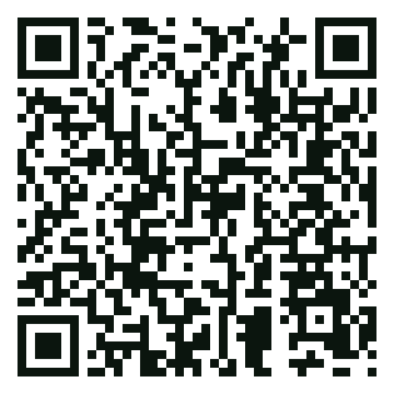


AI AT WORK, WITHOUT THE GAPS
PART 4 OF 4
23 / 24
04 · YOUR NEXT STEP
See the full picture
in four minutes
Your six answers looked at AI. The free IT Health Assessment looks at what AI depends on: 18 questions across six areas, with your score the moment you finish.
QUICK CHECK · ABOUT 4 MINUTES
IT Health Assessment
18 questions across six areas, including AI use
A score out of 36 and your weakest area, straight away
Only a business email needed. No call unless you ask
Take the 4-minute check →
SCAN TO START
sevenc.co.za/assessment
WANT TO GO FURTHER?
SELF-CHECK · ABOUT 15 MINUTES
EXPERT REVIEW · ABOUT 1 HOUR
IT Essentials workbook
Free IT & Cybersecurity Assessment
24 questions across eight areas, a score out of 48 and a rand figure for unused licences.
A SevenC specialist reviews 10 areas with you and leaves a written IT Optimisation Roadmap, yours to keep.
sevenc.co.za/it-essentials-guide →
sevenc.co.za/business-it-audit →
No wrong door
Start anywhere and stop anywhere. All three are free, there’s nothing to sign, and every result is yours to keep.
Free
Nothing to sign
Yours to keep
No jargon
SevenC · IT by Design
↑ Back to contents
sevenc.co.za/assessment
Notes:
Main CTA: 4-minute IT Health Assessment (sevenc.co.za/assessment). Links carry UTM tags (utm_source=ebook, utm_medium=pdf, utm_campaign=ai-at-work-ebook). The IT Essentials workbook URL (sevenc.co.za/it-essentials-guide) must be live before publishing.

Slide 24

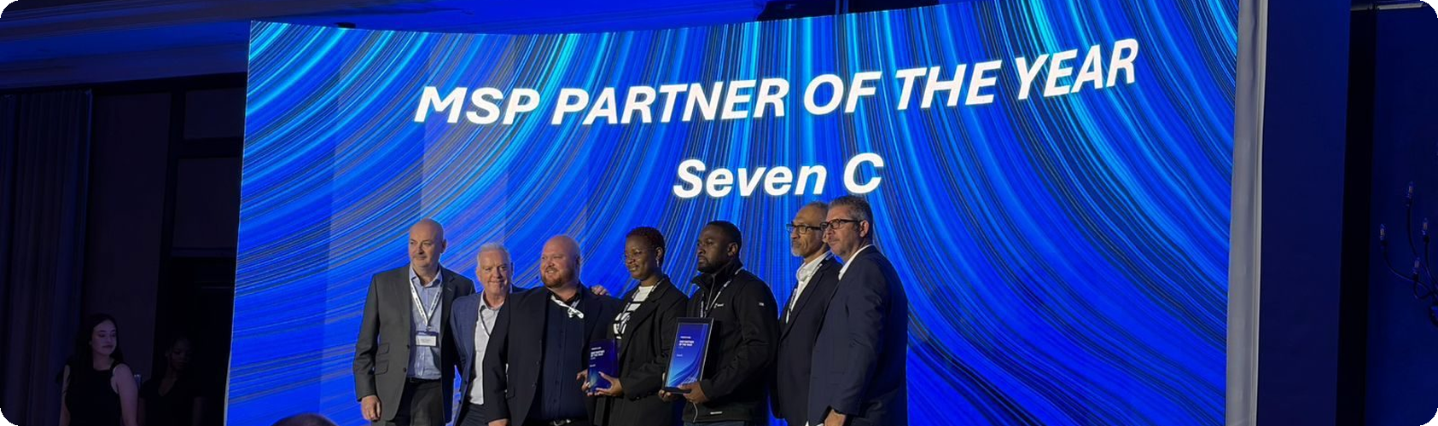


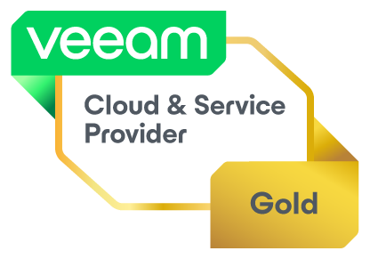
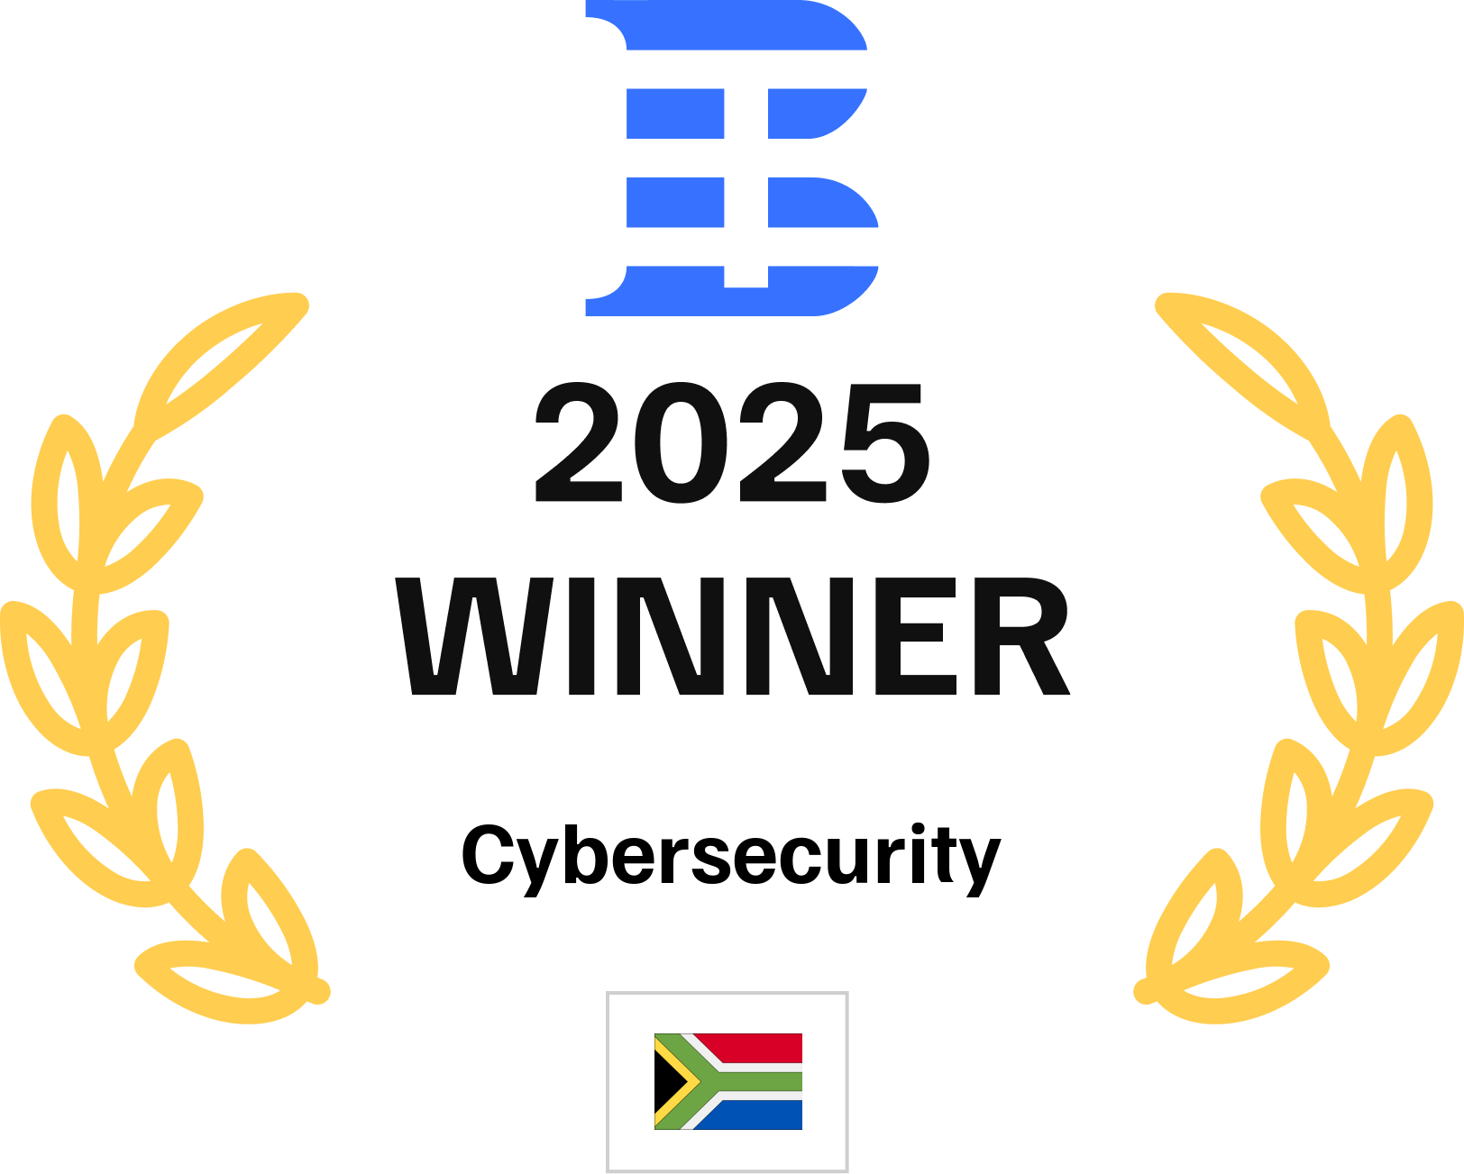
IT BY DESIGN
One partner.
Every layer owned.
SevenC has looked after South African businesses’ IT since 1998: managed IT, cybersecurity, cloud, backup and virtual IT director support, with one accountable team.
SEVENC ON STAGE · SOPHOS MSP PARTNER OF THE YEAR 2026
1998
30–60 min
Next day
2026
SINCE
RESPONSE TIME
ON-SITE
SOPHOS MSP PARTNER OF THE YEAR
SOPHOS PLATINUM PARTNER · MICROSOFT SOLUTIONS PARTNER · VEEAM GOLD · TECH BEHEMOTHS 2025 CYBERSECURITY WINNER, SOUTH AFRICA
TALK TO US
VISIT US
ONLINE
+27 (0)11 467 3388
info@sevenc.co.za
Unit 36, Sunninghill Office Park,
Peltier Drive, Sunninghill, Johannesburg
sevenc.co.za
sevenc.co.za/assessment
SOURCES
1 Microsoft & LinkedIn, Work Trend Index 2024
2 World Wide Worx, SA Generative AI Roadmap 2025
3 IBM, Cost of a Data Breach Report 2025
4 Microsoft, Digital Defense Report 2025
5 Sophos, Active Adversary Report 2026
6 Computerworld, Copilot Chat pricing, Nov 2025
7 OpenAI Help Center, data controls, 2026
8 Microsoft Learn, enterprise data protection, 2026
9 Microsoft Learn & Support, M365 retention, 2024–26
10 SABRIC, Annual Crime Statistics 2024
11 ENS via Mondaq, POPIA section 72, 2020
We never sell or share your details. · SevenC Computing (Pty) Ltd · Reg 2009/014578/07
Notes:
Back cover. Proof uses facts from the Design System README: since 1998, 30 to 60 minute response and next-day on-site (IT Essentials), Sophos MSP Partner of the Year 2026 (Channelwise, 12 June 2026: https://channelwise.co.za/sophos-recognises-top-partners/). Avoided on purpose: 800+ clients (conflicts with 500+ on the AI at Work page) and the Sophos MDR exclusivity claim (flagged). Sources list covers every statistic and quoted vendor term in the extended edition. Partner and award badges from the Partner Logos group, including the Tech Behemoths 2025 Cybersecurity winner badge (South Africa); the Design System lists this award under facts to check before publishing.

